Slide 1
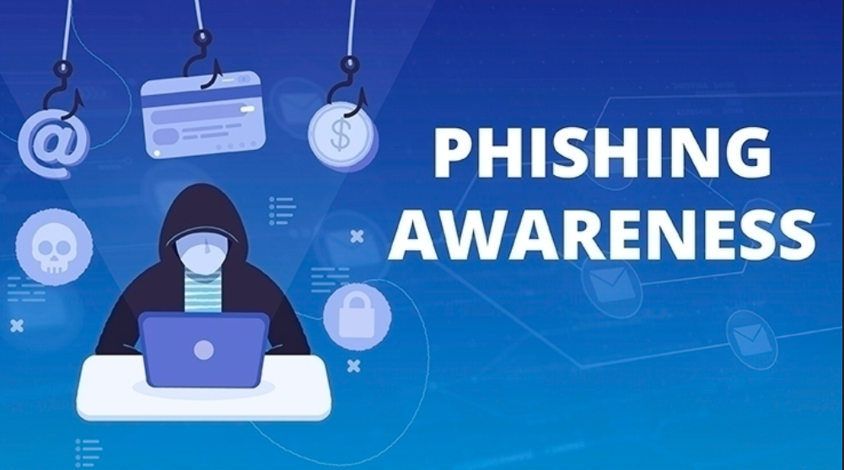
Recognizing and Avoiding Phishing Emails, Websites, and Social Engineering Muhammad Raza /CodeAlpha

Slide 2

Introduction to Phishing
Phishing is a type of cyberattack where attackers pose as legitimate entities to trick individuals into revealing sensitive information such as passwords, credit card numbers, or personal details.
Common Methods:
Emails
Websites
Phone Calls/SMS (Smishing)
Social Media (Vishing)

Slide 3
Phishing Statistics
Key Stats:
90% of data breaches involve phishing attacks.
The average cost of a phishing attack for an organization is over $3.8 million.
Over 3.4 billion phishing emails are sent every day.
Relevance:
Every individual is a target, from employees to personal email users.

Slide 4
How Phishing Works
Phases of a Phishing Attack:
Preparation: The attacker researches and prepares their bait (fake websites, emails, etc.).
Attack: The phishing email or message is sent to the target.
Exploitation: The victim provides personal information or clicks on malicious links.
Execution: The attacker uses the stolen information for fraud or data breaches.

Slide 5
Recognizing Phishing Emails
Red Flags to Look For:
Urgent Language: "Your account has been compromised!"
Suspicious Sender: Check the email address carefully.
Mismatched URLs: Hover over links to verify their authenticity.
Unfamiliar Attachments: Avoid opening unexpected or unfamiliar attachments.
Poor Grammar and Spelling Errors: Professional companies rarely make basic mistakes.

Slide 6
Recognizing Phishing Websites
Identifying Fake Websites:
URL Mismatch: Check the URL—fake websites may have subtle misspellings.
No SSL Certificate: Look for the lock symbol and "https" in the address bar.
Design Inconsistencies: Fake sites often have poor design, missing images, or outdated information.
Pop-Ups Asking for Personal Information: Legitimate companies rarely ask for sensitive information via pop-up forms.

Slide 7
Social Engineering Tactics
Types of Social Engineering:
Pretexting: Pretending to be someone in authority to extract sensitive data.
Baiting: Offering something tempting, such as free software, to gain access to your system.
Quid Pro Quo: Offering services or help in exchange for information.
Tailgating: Physically following someone into a restricted area.
Tip: Always verify the identity of anyone requesting sensitive information, even if they seem to be from a trusted organization.

Slide 8
Steps to Protect Yourself
What You Can Do:
Verify Sender's Identity: Call or contact the organization through trusted channels if an email seems suspicious.
Don’t Click on Suspicious Links: Hover over links and double-check their URLs before clicking.
Enable Two-Factor Authentication (2FA): This adds an extra layer of security, even if your password is compromised.
Update Software Regularly: Keep your operating systems, browsers, and antivirus software up to date.
Use Anti-Phishing Toolbars: Many browsers have anti-phishing features that can block suspicious sites.

Slide 9
What to Do If You’re Phished
Immediate Actions:
Disconnect from the Internet: Prevent the attacker from accessing your system.
Change Passwords Immediately: Use a password manager to create strong, unique passwords.
Notify Your IT Department or Security Team: Inform them so they can take appropriate measures.
Monitor Your Accounts for Unusual Activity: Look for unauthorized transactions or changes in your accounts.

Slide 10
Case Study - Twitter Phishing Attack (2020)
Target: High-profile Twitter accounts (Elon Musk, Obama, etc.)
Method: Social engineering + phishing emails to Twitter employees
Attack: Gained access to internal tools, sent fraudulent tweets promoting a cryptocurrency scam
Impact: Over $100,000 stolen, major reputational damage for Twitter
Lessons:
Train employees to recognize phishing
Use Two-Factor Authentication (2FA)
Respond quickly to limit damage

Slide 11
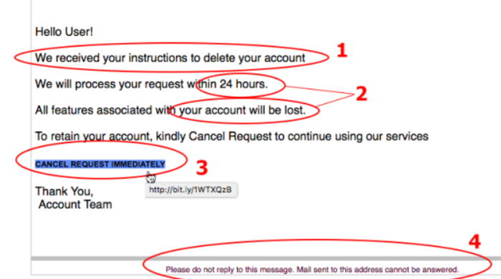
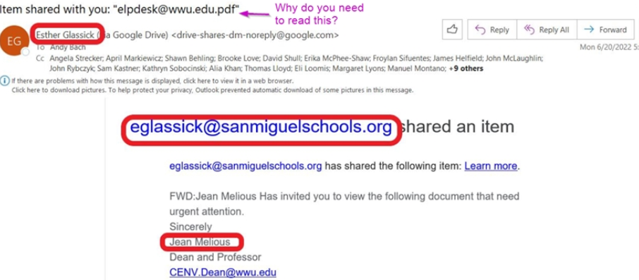
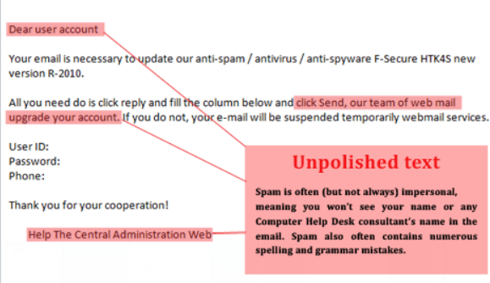
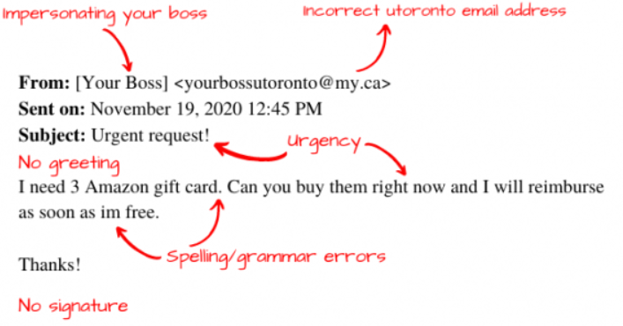
Email Examples Or Website Screenshots.

Slide 12
Examples:
Email 1: A suspicious email asking you to reset your bank password.
Red Flags: Unfamiliar sender, poor grammar, urgent request.
Email 2: An official-looking email from Amazon regarding an order you didn’t place.
Red Flags: Mismatched sender address, generic greeting ("Dear customer"), attachment.
Website Example: A login page that looks like PayPal, but the URL is slightly misspelled.
Red Flag: Mismatched or misspelled URL.

Slide 13
Conclusion
Summary:
Phishing attacks are one of the most common cyber threats, but they can be avoided by staying vigilant and following best practices.
Final Tips:
Always verify before you trust.
Educate your colleagues and friends about phishing risks.
Stay updated with the latest cybersecurity practices.

Slide 14


